Slide 1
Age Classification Using Deep Learning Techniques
Project Guide : Dr Krishan Kumar Sethi
Group Members Name : | Roll Number :
Ahmar Hasan Arish | 2006110
Ankit Kumar | 2006115
Vishal Anand | 2006181

Slide 2
Contents
Introduction
Proposed Approaches
Performance Evaluation
Conclusion
References

Slide 3
Introduction
What is the need of Age classification?
Face Recognition And Authentication
Content Recommendation
Targeted Advertising
Age Verification
Age-specific Health Care
Customized User Experience

Slide 4
Proposed Approach for Age Classification
CNN Model
Xception Model

Slide 5
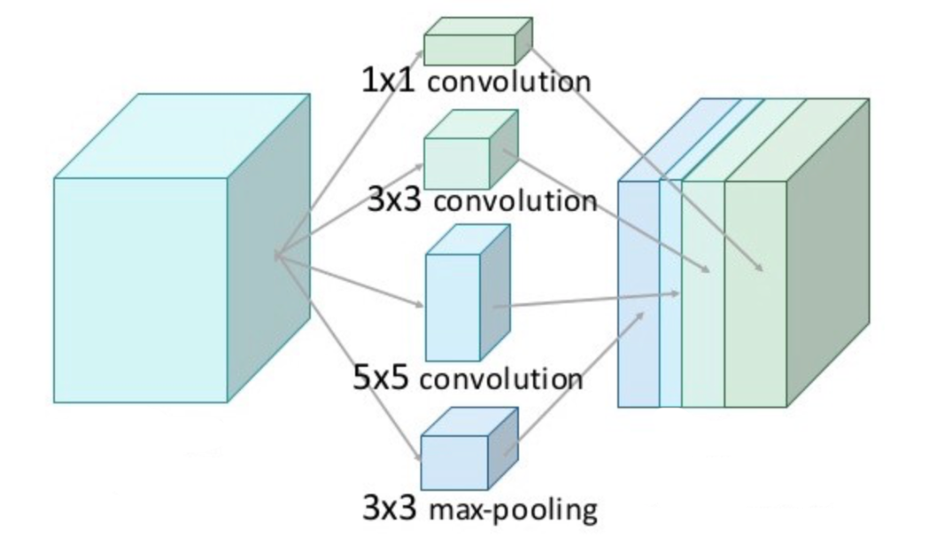
Xception Model
Inspired by Google's Inception model
The Xception architecture is a linear stack of depth wise separable convolution layers with residual connections
It is 71 layers deep.

Slide 6
Xception Model
Depth Modification You can adjust the depth of the Xception architecture by adding or removing layers.
Width Modification The width of the network refers to the number of filters or units in each layer. It can be increased or decreased.
Resolution Modification You can adapt Xception for different input image resolutions.

Slide 7
Dataset - Used
The Indian Movie Face database (IMFDB) is a large unconstrained face database consisting of 34512 images of 100 Indian actors collected from more than 100 videos. All the images are manually selected and cropped from the video frames resulting in a high degree of variability in terms of scale, pose, expression, illumination, age, resolution, occlusion, and makeup. IMFDB is the first face database that provides a detailed annotation of every image in terms of age, pose, gender, expression and type of occlusion that may help other face related applications.
The attributes of data are as follows :-
ID – Unique ID of image
Class – Age bin of person in image (young , middle ,old)

Slide 8
Data Pre-processing :
The input images are resized to 150x150 pixels before being fed into the model.
Labels are one-hot encoded.
Batch size used is of 32,it indicates that the generator will generate batches of 32 samples each.

Slide 9
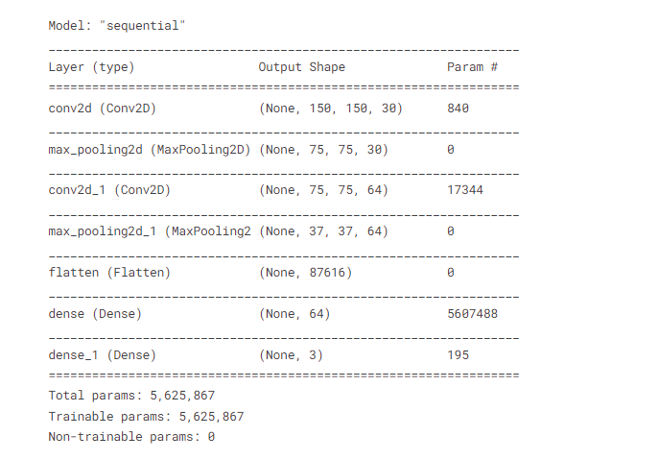
CNN Model Summary

Slide 10
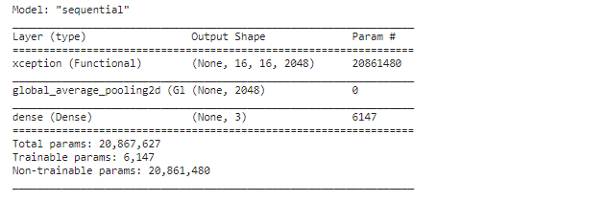
Xception Model Summary

Slide 11
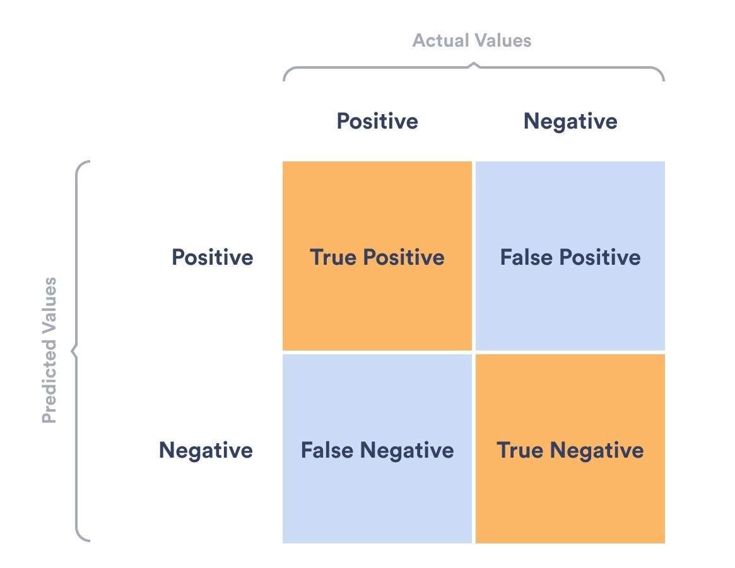
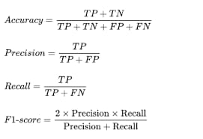
Evaluation Matrices

Slide 12
Results And Discussion:
Models | Accuracy (%) | F1 Score (%) | Precision (%) | Recall (%)
CNN | 87.3 | 91.7 | 91.8 | 91.5
Xception |  | 80.1

Slide 13
Conclusion

Slide 14
Refrences
A. Garain, B. Ray, P. K. Singh, A. Ahmadian, N. Senu and R. Sarkar, "GRA_Net: A Deep Learning Model for Classification of Age and Gender From Facial Images," in IEEE Access, vol. 9, pp. 85672-85689, 2021, doi: 10.1109/ACCESS.2021.3085971.
N. Shanthi, P. Yuvasri, S. Vaishnavi and P. Vidhya, "Gender and Age Detection using Deep Convolutional Neural Networks," 2022 4th International Conference on Smart Systems and Inventive Technology (ICSSIT), Tirunelveli, India, 2022, pp. 951-956, doi: 10.1109/ICSSIT53264.2022.9716377.

Slide 15


